Slide 1


Slide 2
Shirts and Tops:
Must have a collar and be a solid color.
With the exception of brand/manufacturers’ logos/labels, shirts and tops may not contain insignias, logos, labels, graphics, embroidery, words, monograms or pictures.
Must be appropriately sized and long enough to cover the midriff, chest and back of the body while sitting and standing.

Slide 3
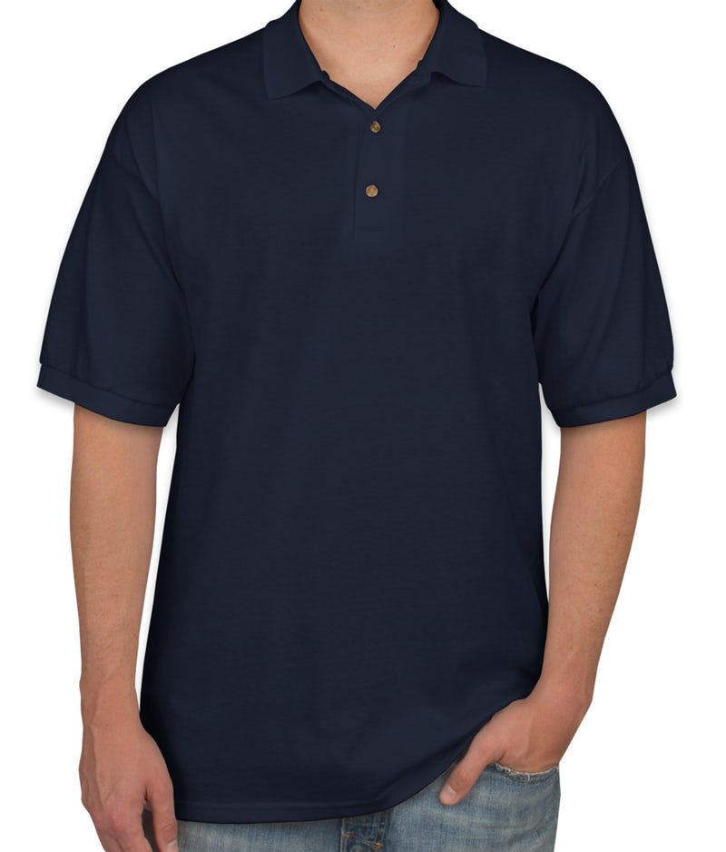
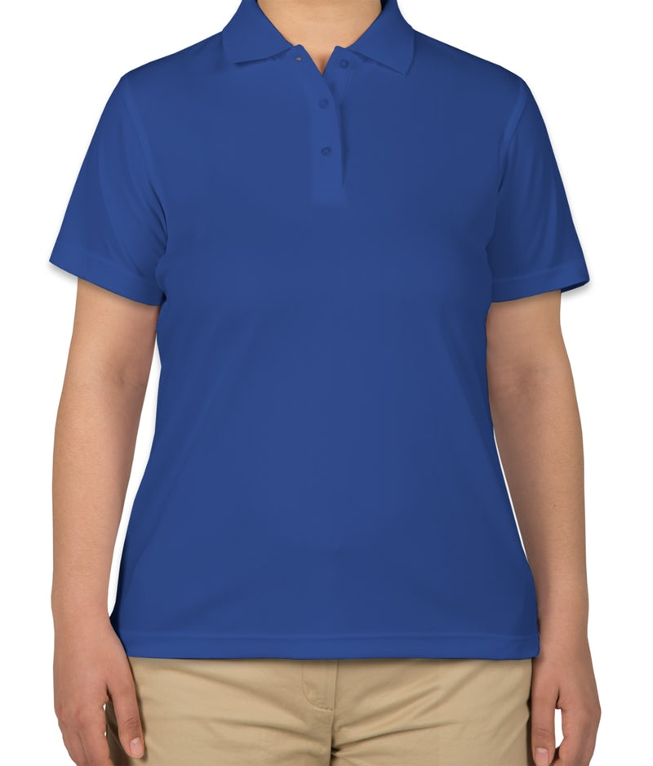
Shirts and Tops examples:
YES!

Slide 4
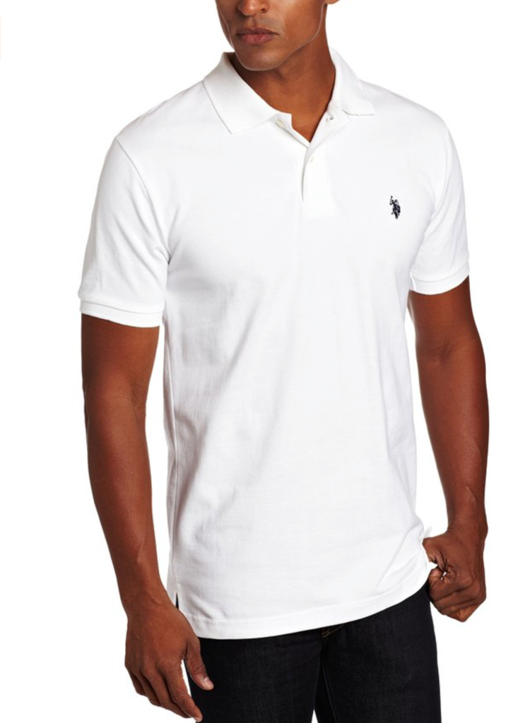
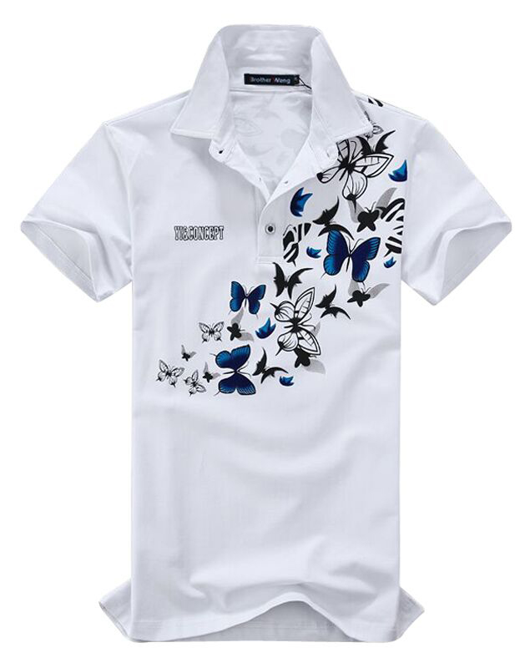
Shirts and Tops examples:
With the exception of
brand/manufacturers’
logos/labels,
shirts and tops may not
contain insignias, logos, labels,
graphics, embroidery,
Monograms, words or pictures.
Yes!
No!

Slide 5
Bottoms and Dresses
(Jumpers, pants, capris, shorts, skorts, jeans, leggings, yoga pants, and skirts)
Must be solid khaki, black, or navy, with the exception of dresses which may be any solid color.
Must be of sufficient length.
  May not be above student’s fingertips when the student’s arms are relaxed at his/her sides.
Denim bottoms must be solid khaki, black or navy. Are not allowed to have cuts or holes.
  “Blue Jeans” are acceptable.
With the exception of manufacturer’s logos/labels, bottoms and dresses may not contain insignias, logos, labels, graphics, embroidery, words or pictures.

Slide 6
Bottoms and Dresses (continued):
(Jumpers, pants, capris, shorts, skorts, jeans, leggings, yoga pants, and skirts)
Must be appropriately sized. Pants and shorts must be worn with the waist line at or above the hip bone.
  No baggy or sagging pants or shorts allowed.
  No ”low rise” clothing is allowed.
If belts are worn, they must not be oversized and must be buckled.
Dresses must have a collar and sleeves.
Footed tights may be worn under pants, capris, shorts, skorts, skirts, and jumpers.
  No fishnet stockings are allowed.

Slide 7
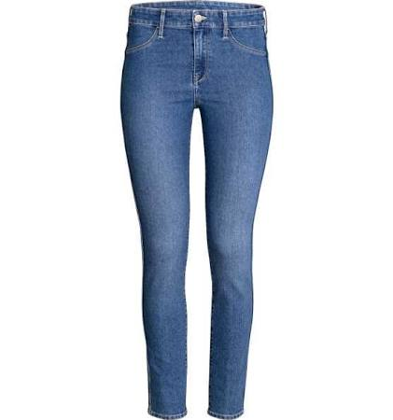
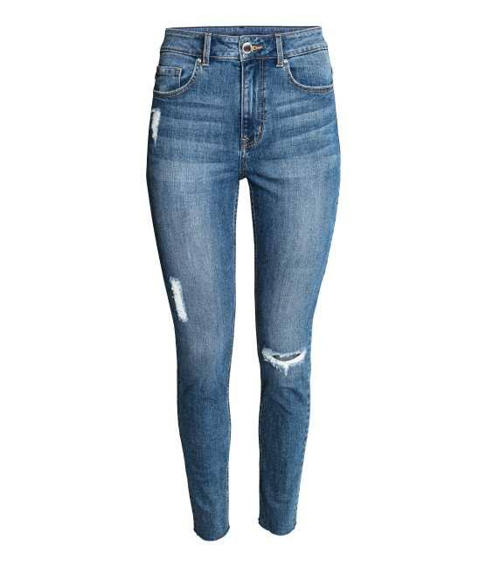
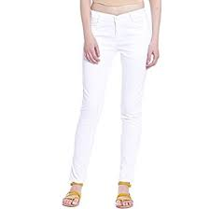
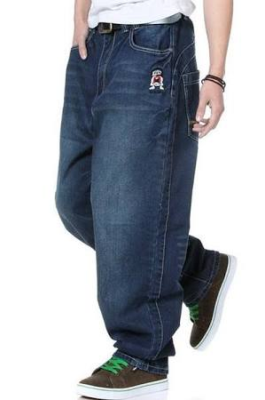
Blue Jeans examples:
Yes!
No!
Pants are not allowed to
have holes in them.
No!
Pants are wrong color, must be
navy (blue jeans), khaki or black.
No!
Pants should not be baggy
and cannot sag.

Slide 8
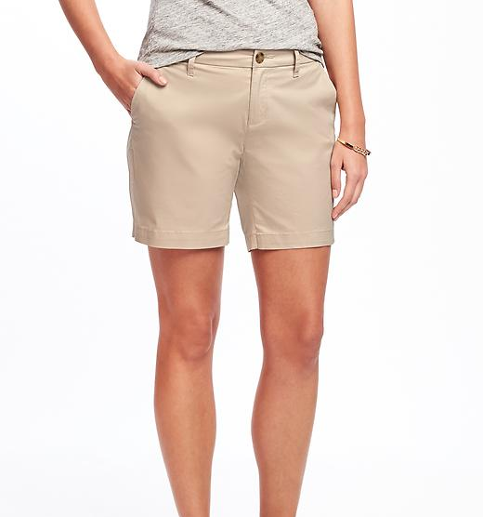
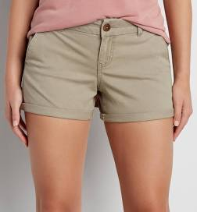
Shorts, Skirt and Dress Length examples:
Length of shorts must be
below the fingertips.
Yes!
No!

Slide 9
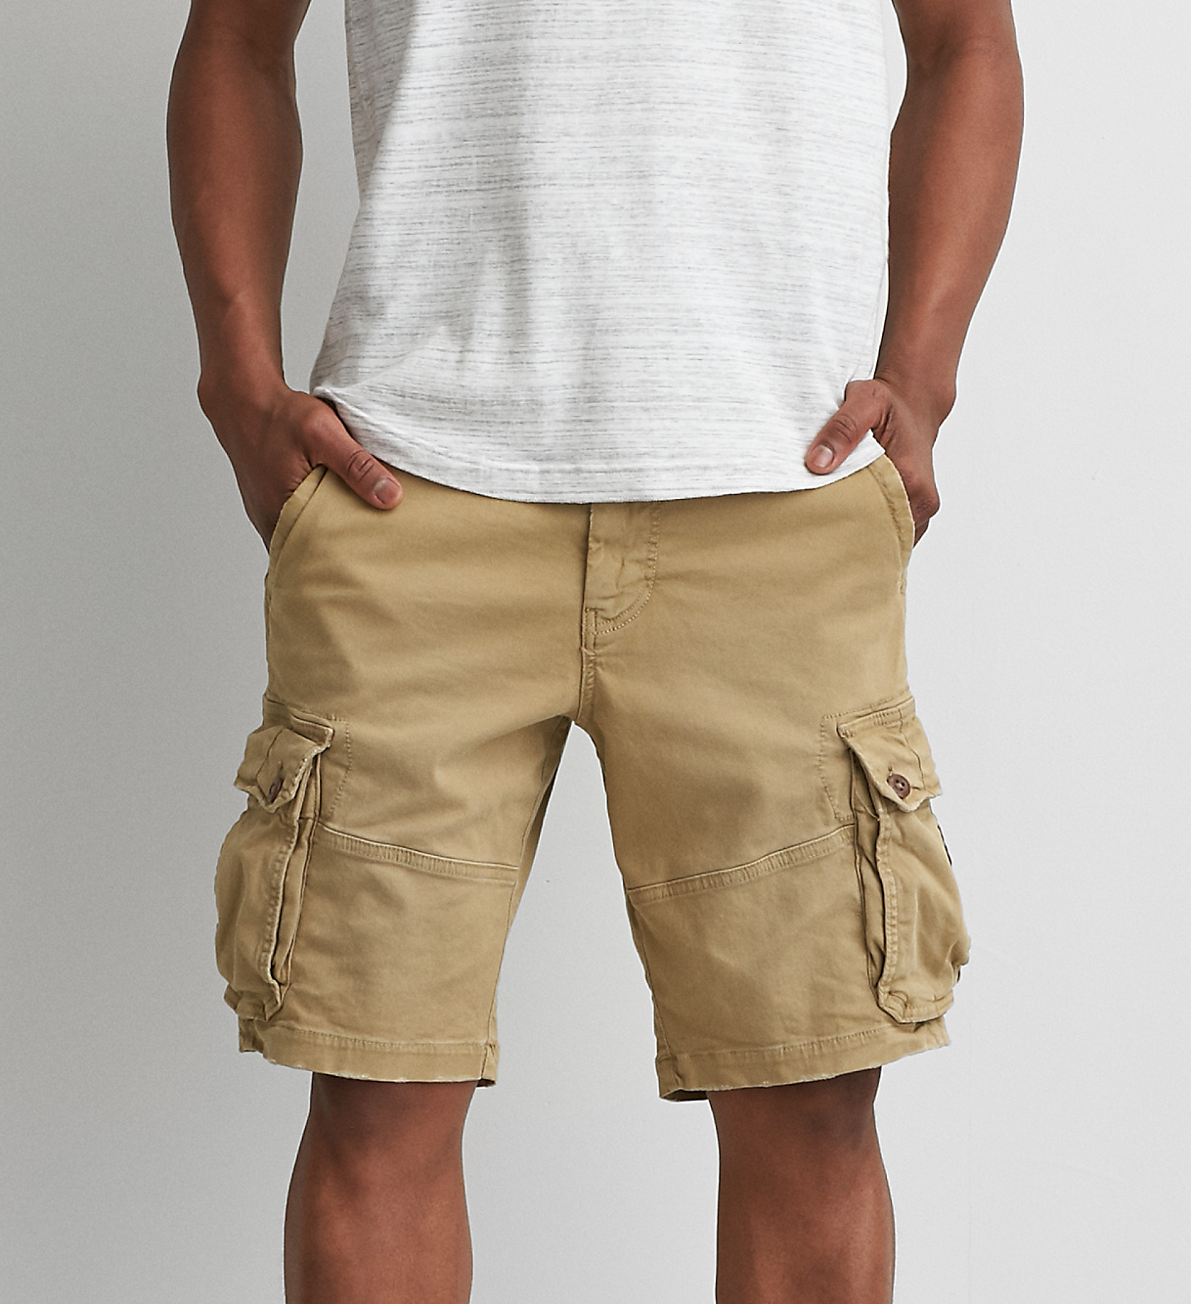
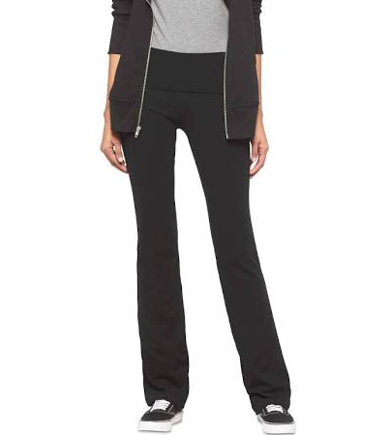
Bottoms examples:
Cargo shorts,
leggings and
yoga pants
are acceptable if
meet other requirements.
Yes!
Yes!

Slide 10
Shoes:
Must be worn at all times.
Must conform to the requirements for specific classes or activities as necessary.
  PE, JROTC, Science Labs, etc.
No bedroom slippers allowed.
If shoes have laces, they must be laced and tied.

Slide 11
Outerwear:
Solid color sweatshirts, sweaters, jackets, coats, hoodies and vests may be worn over school attire.
With the exception of brand/manufacturer’s logos/labels, outerwear may not contain insignias, logos, labels, graphics, embroidery, monograms, words or pictures.
Hoodies and hooded jackets may not have the hood covering the head while in the school building.
  Violation may result in not being allowed to wear a hoodie in the school.

Slide 12
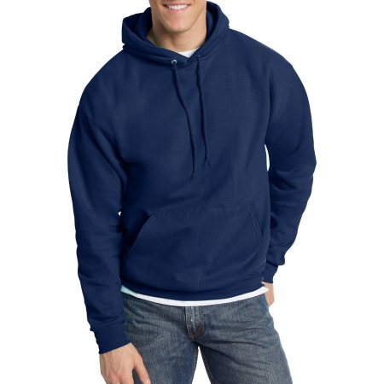
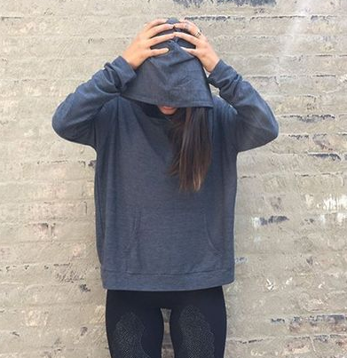
Outerwear examples:
Hood may not cover
head.
Yes!
No!

Slide 13
Spirit Wear and School Club Wear:
Principals, at their discretion, will have the authority to approve school spirit wear and school club wear to be worn on any school day.
This includes t-shirts, sweatshirts, fleece jackets, and hoodies.

Slide 14

Spirit Wear and School Club Wear example:
Yes!

Slide 15
Other Clothing Items and Accessories:
Clothing must be worn as intended.
Undergarments may not be visible at any time.
No see through or mesh clothing permitted.
Gang-related clothing or accessories are not permitted.
Headwear, sunglasses and bandanas are not permitted.
Solid color, patterned or striped ties may be worn.

Slide 16
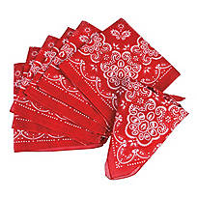
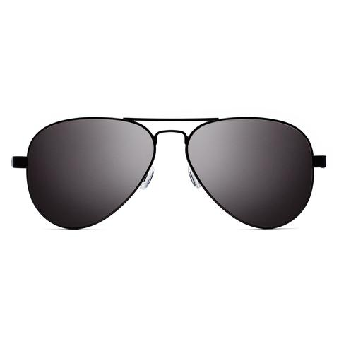
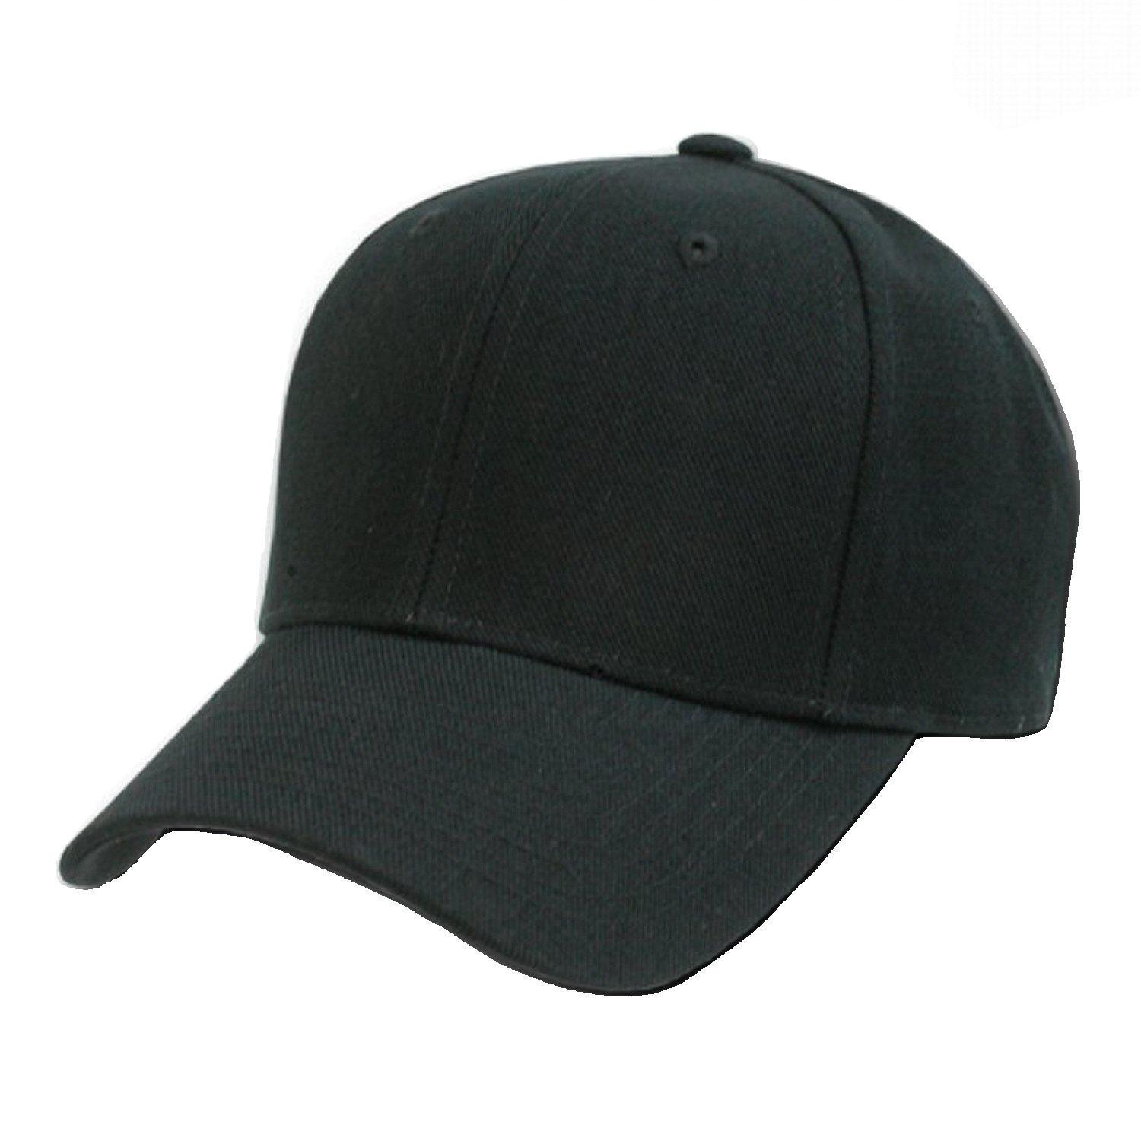
Other Clothing Items and Accessories examples:
No!
No!
No!

Slide 17
Noncompliance with this policy is a violation of the Student Code of Conduct and will be subject to the consequences therein.
See full Board Policy 4316 for details on religious or medical waivers, special activity accommodations, and principal exceptions.
www.pittschools.org

